Slide 1
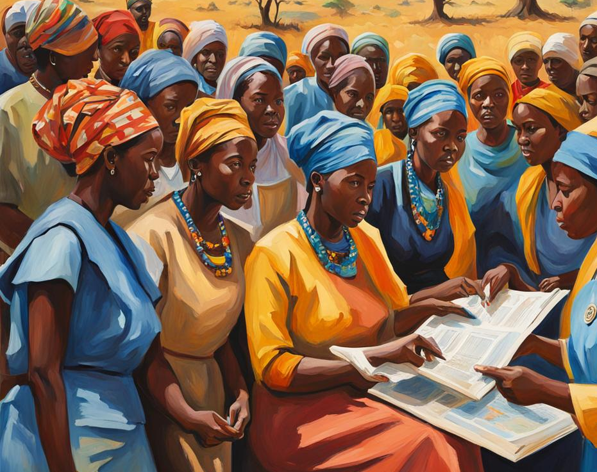
Closing the Gender Gap in Climate
Sam Lee
04/15/2024

Slide 2
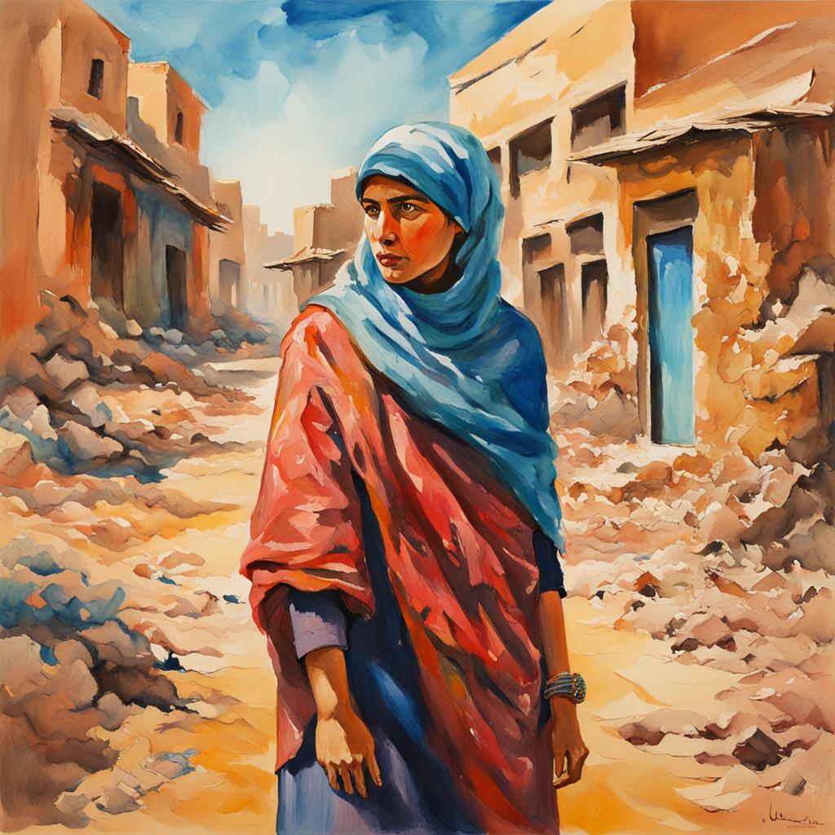

Background & Motivation
Women are disproportionately affected by negative externalities of climate change
Parliaments with higher concentrations of women $→$ Stricter Climate Policies (Mavisakalyan & Tarverdi, 2019)
Little research on an intertemporal causal link

Slide 3
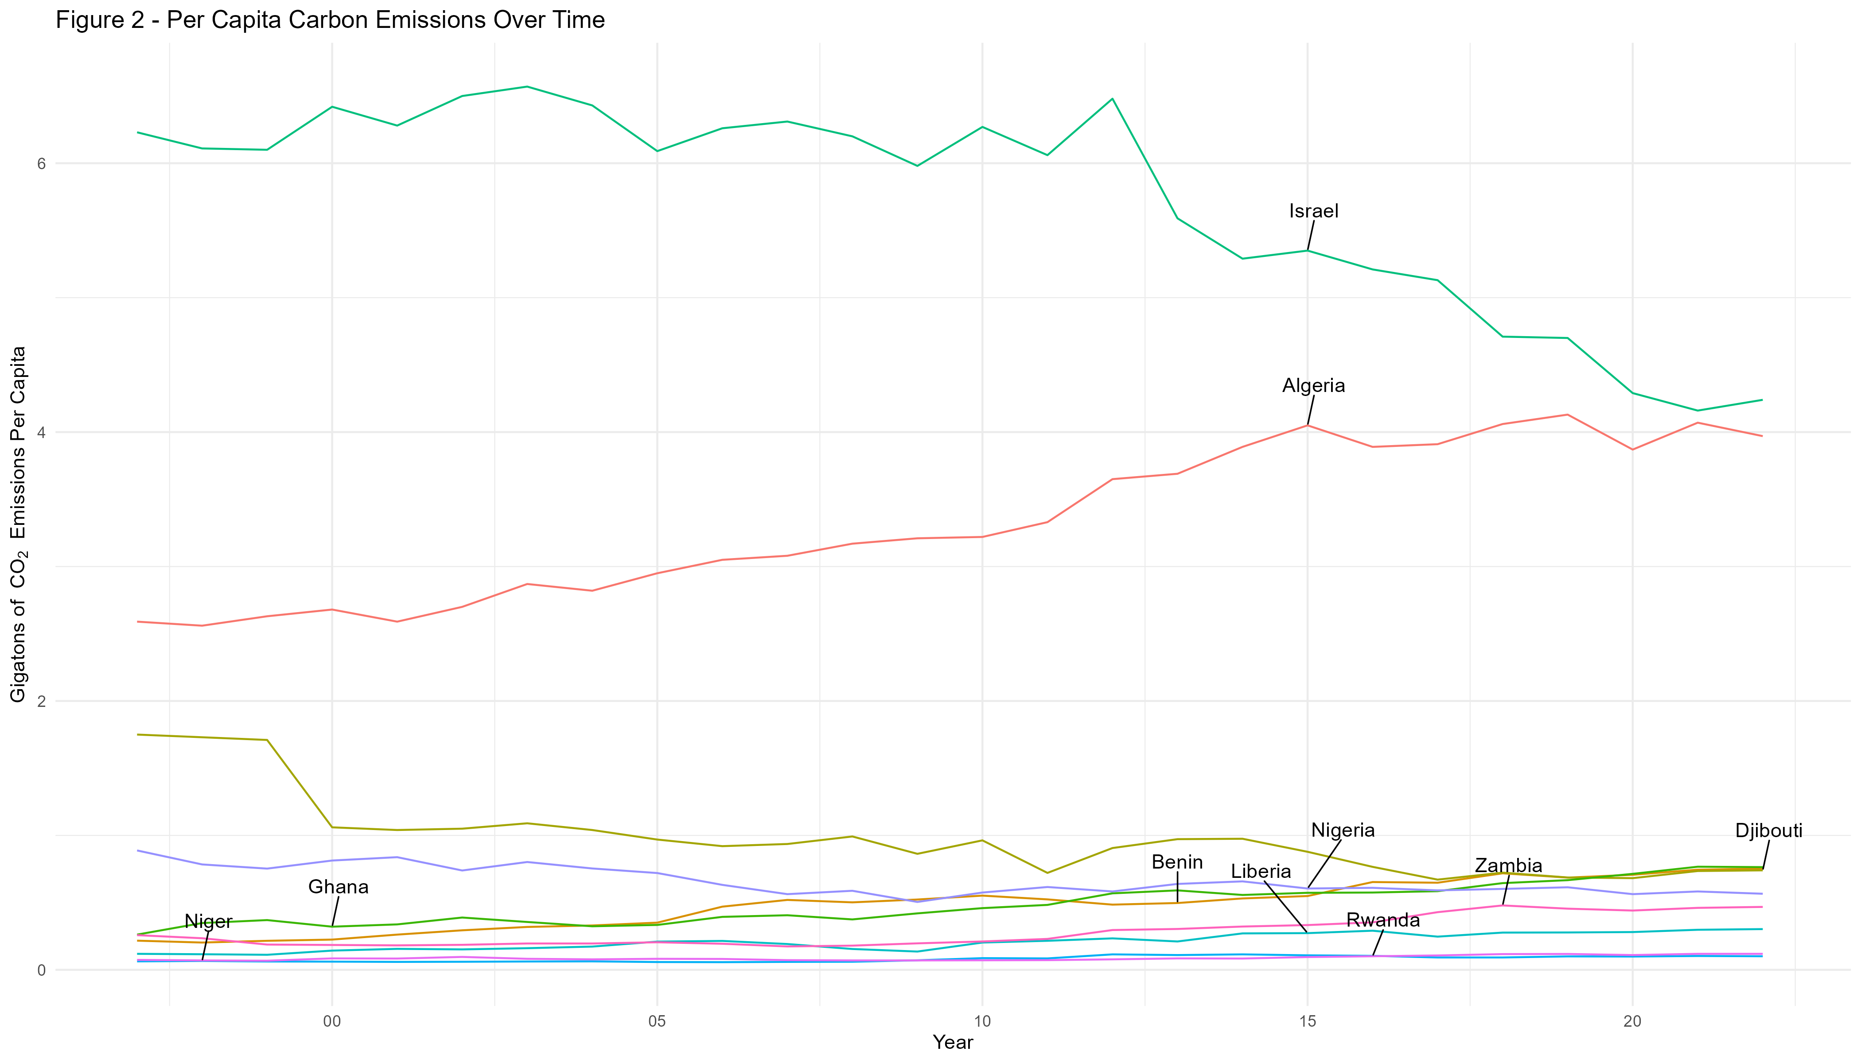
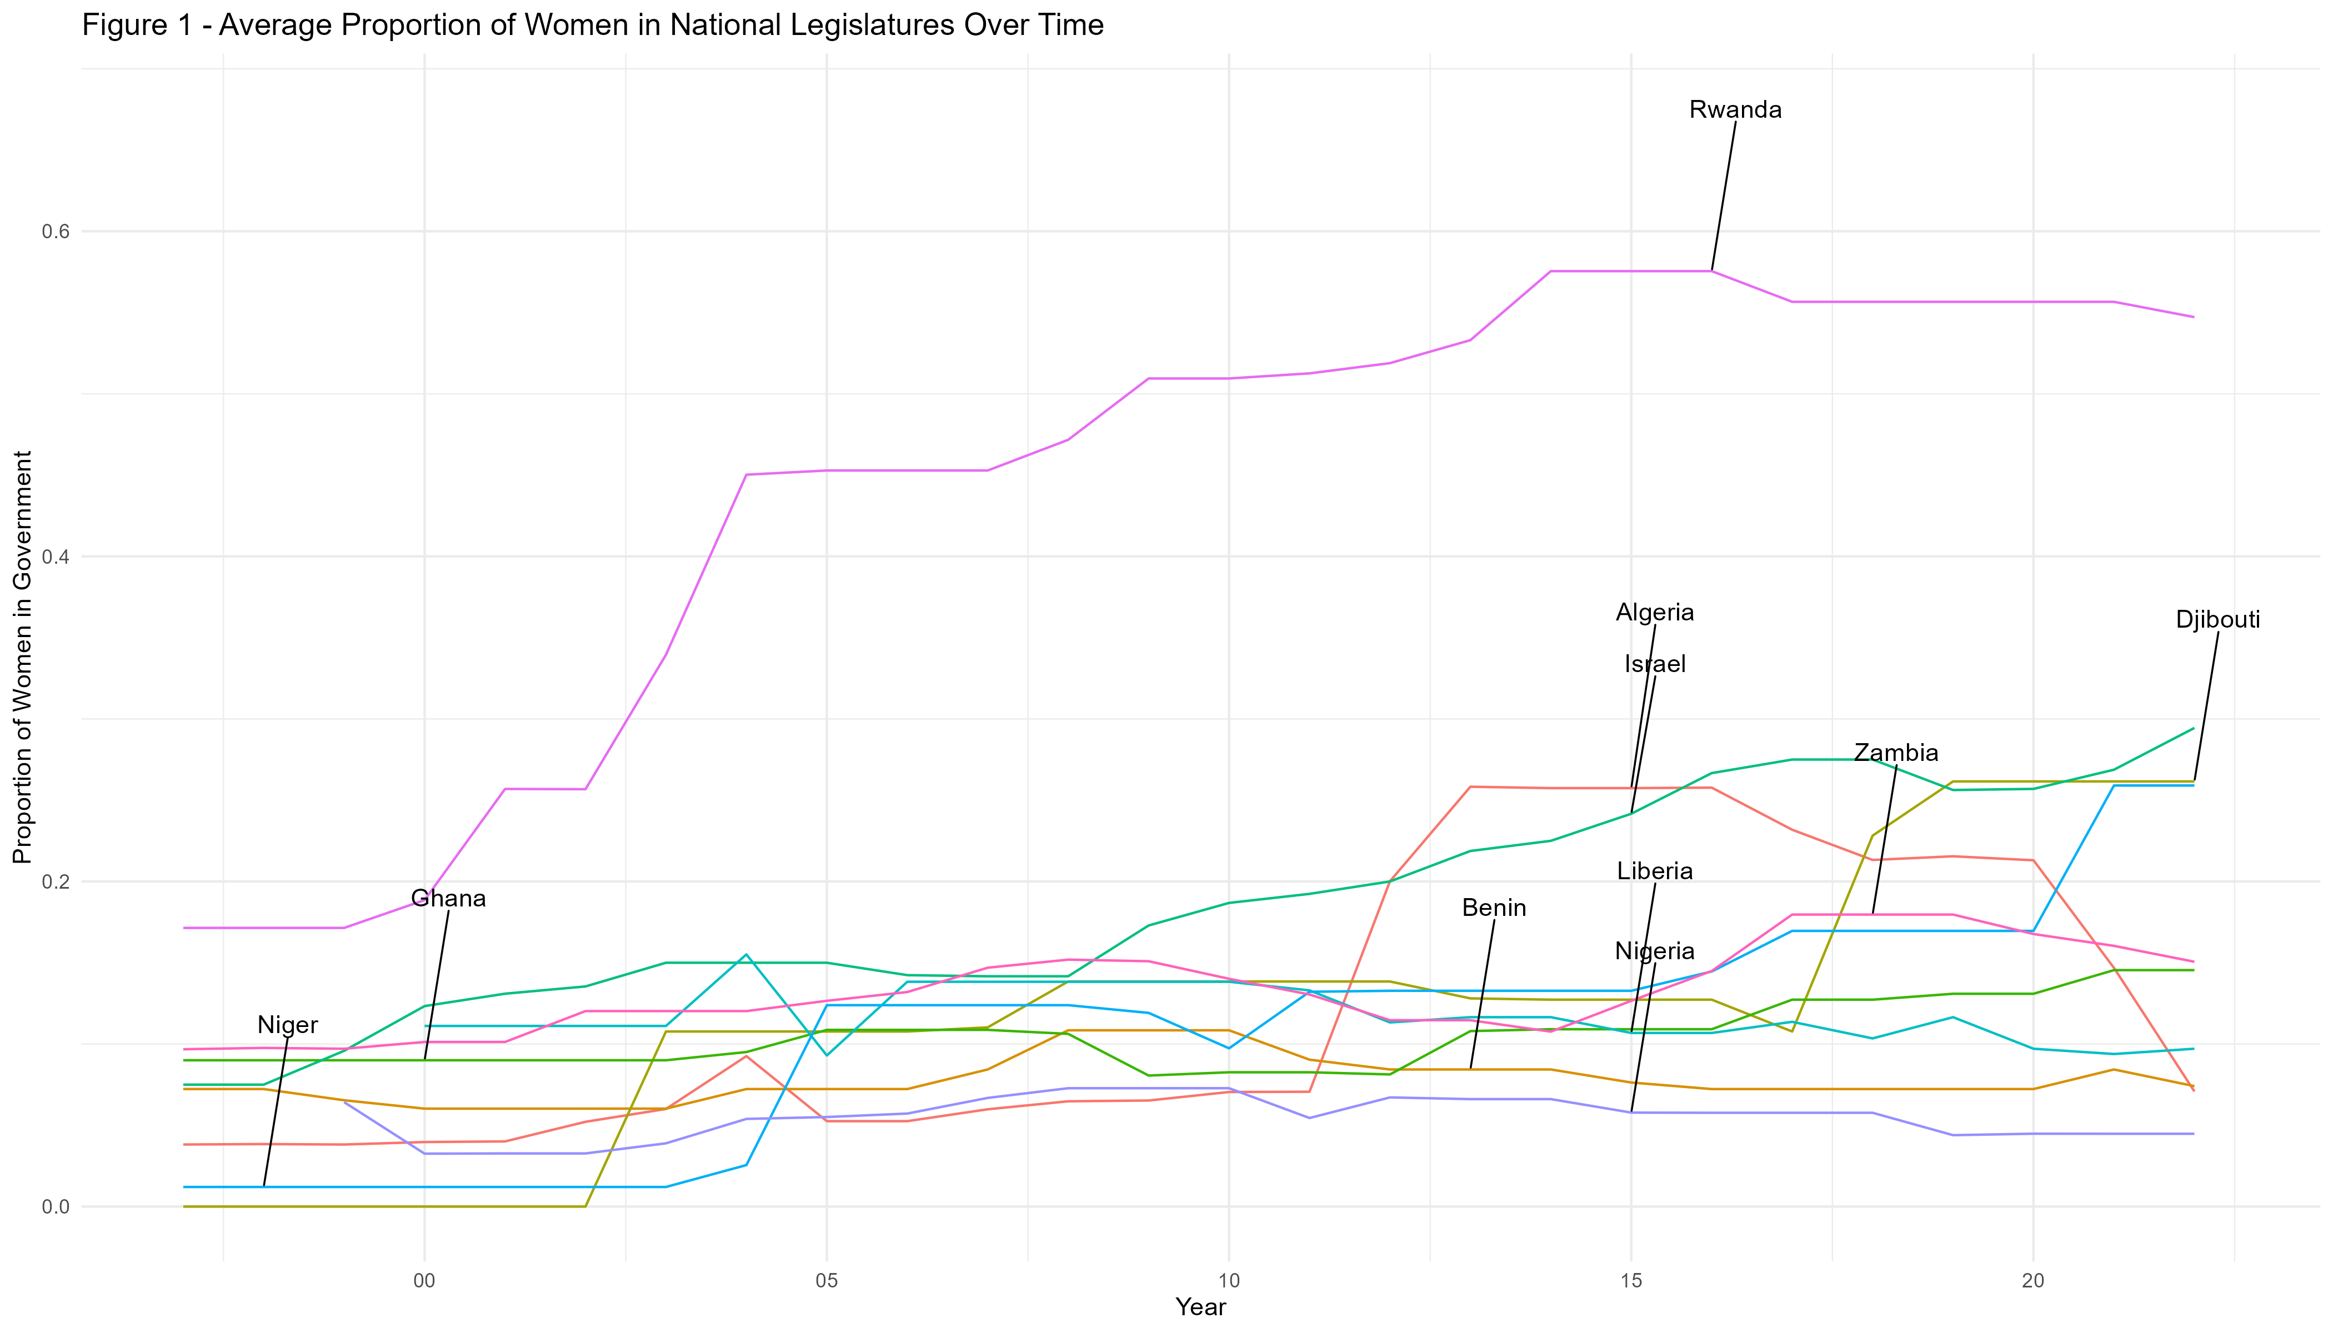
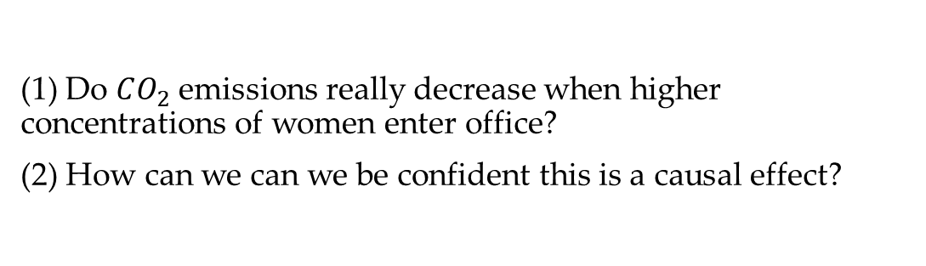
Background & Motivation
(1) Do $CO_{2}$ emissions really decrease when higher concentrations of women enter office?
(2) How can we can we be confident this is a causal effect?

Slide 4
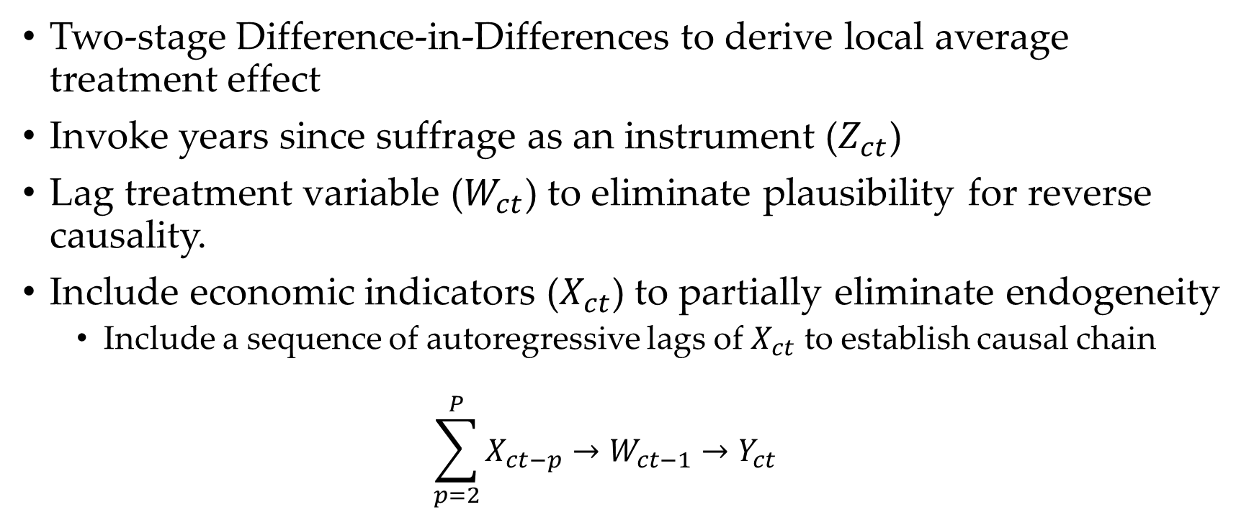
Identification Strategy
Two-stage Difference-in-Differences to derive local average treatment effect
Invoke years since suffrage as an instrument ($Z_{ct}$)
Lag treatment variable ($W_{ct}$) to eliminate plausibility for reverse causality.
Include economic indicators ($X_{ct}$) to partially eliminate endogeneity
Include a sequence of autoregressive lags of $X_{ct}$ to establish causal chain
$$\sum_{p=2}^{P}{X_{ct−p}}→W_{ct−1}→Y_{ct}$$

Slide 5
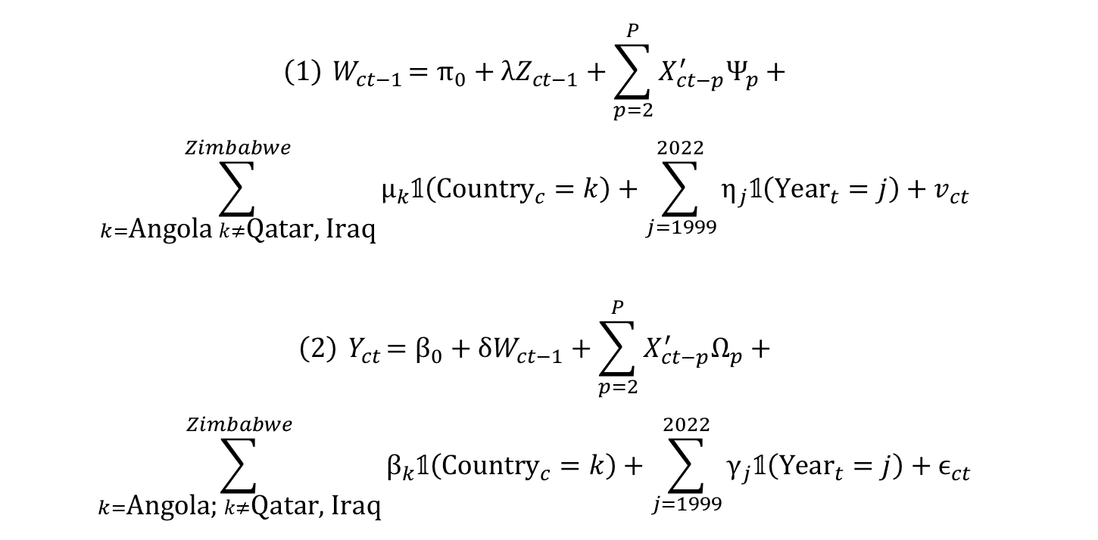
Identification Strategy
$$\left(1\right){ W}_{ct−1}=π_{0}+λZ_{ct−1}+\sum_{p=2}^{P}{X_{ct−p}^{′}Ψ_{p}}+$$
$$\sum_{k=\text{Angola} k≠\text{Qatar}\text{, }\text{Iraq}}^{Zimbabwe}{μ_{k}𝟙\left({\text{Country}}_{c}=k\right)}+\sum_{j=1999}^{2022}{η_{j}𝟙\left({\text{Year}}_{t}=j\right)}+v_{ct}$$
$$\left(2\right){ Y}_{ct}=β_{0}+δW_{ct−1}+\sum_{p=2}^{P}{X_{ct−p}^{′}Ω_{p}}+$$
$$\sum_{k=\text{Angola}\text{; }k≠\text{Qatar}\text{, }\text{Iraq}}^{Zimbabwe}{β_{k}𝟙\left({\text{Country}}_{c}=k\right)}+\sum_{j=1999}^{2022}{γ_{j}𝟙\left({\text{Year}}_{t}=j\right)}+ϵ_{ct}$$

Slide 6
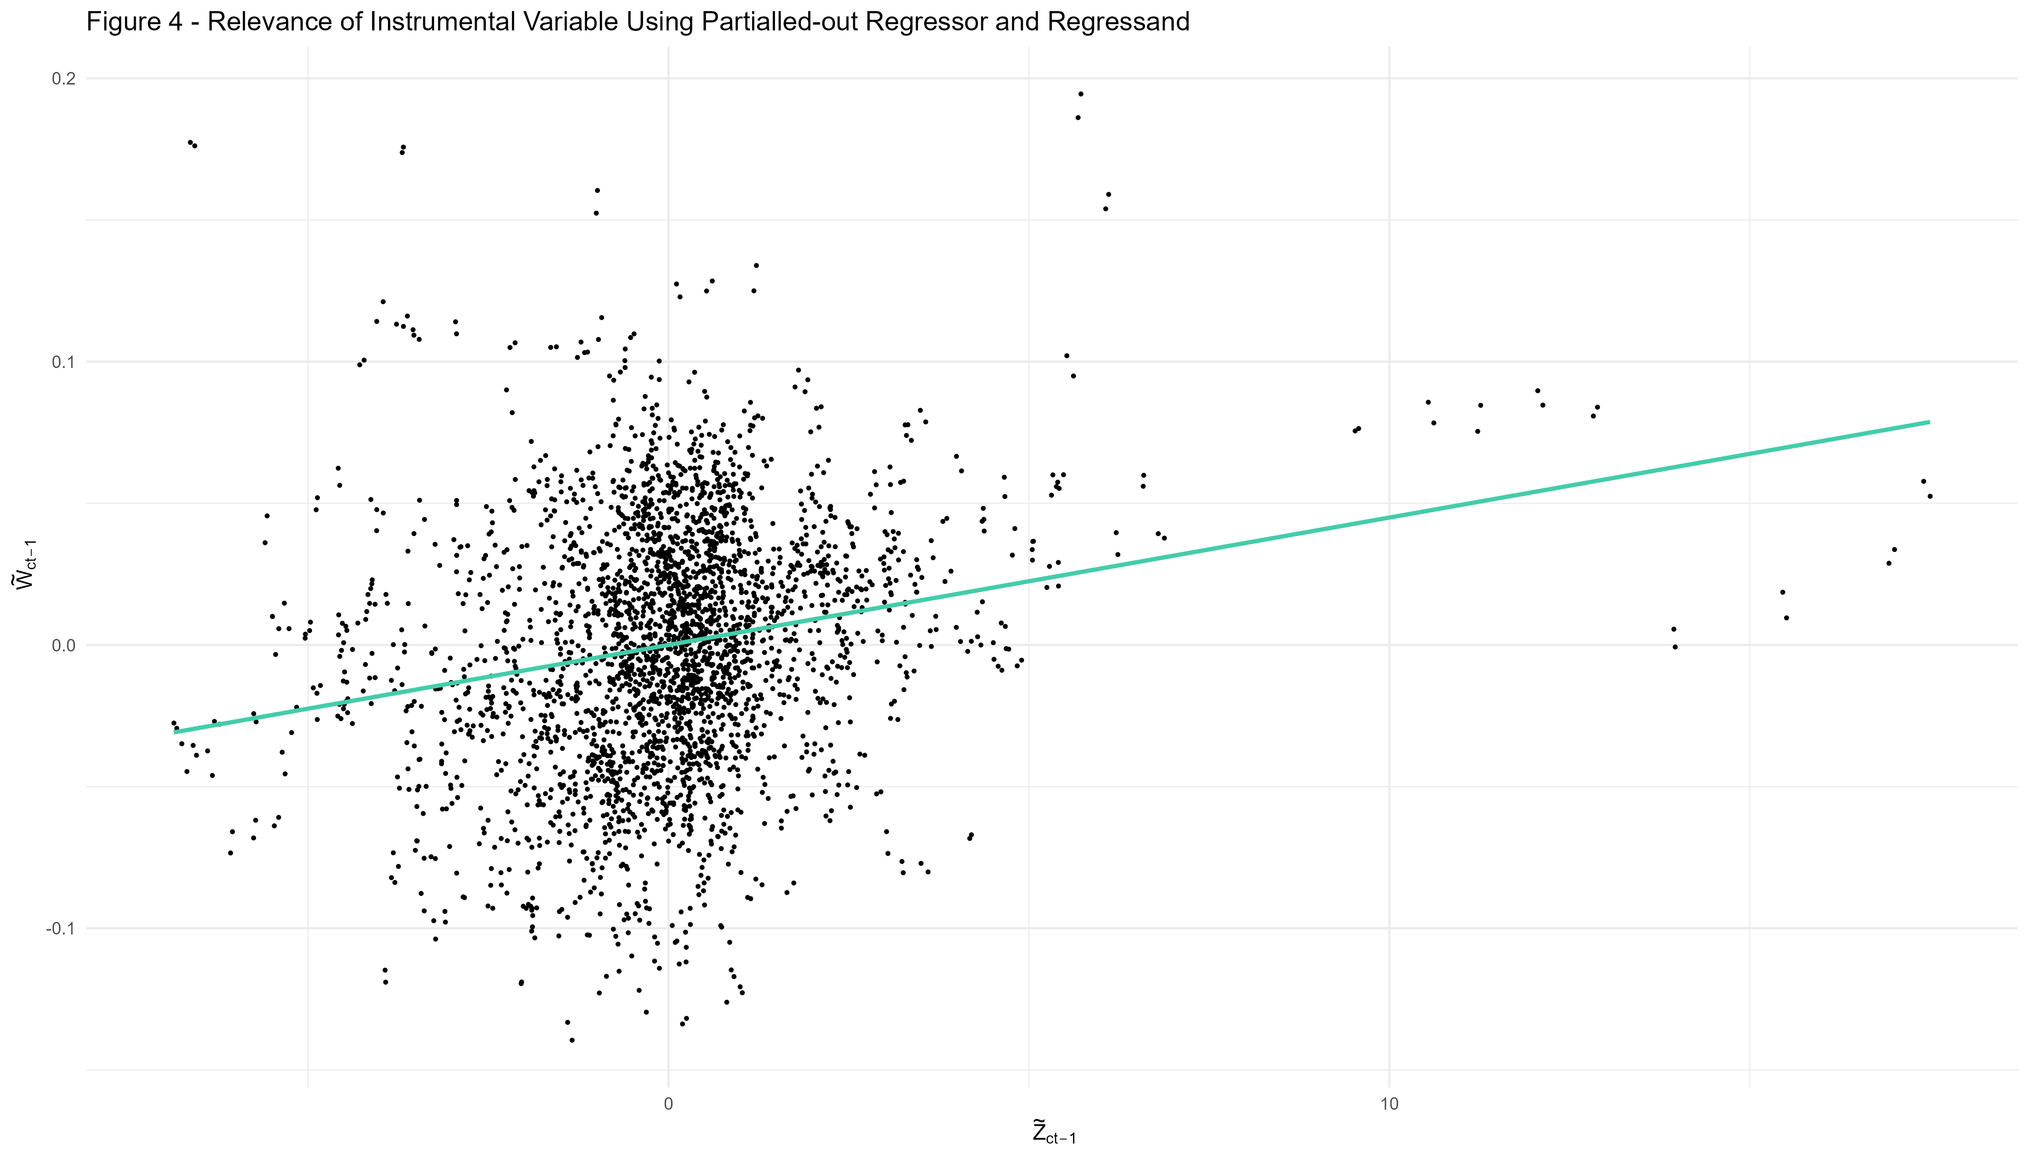
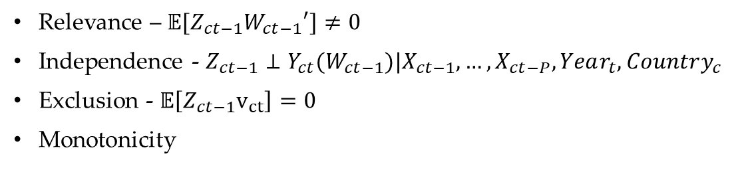
Assumptions for Identification - IV
Relevance – $𝔼[Z_{ct−1}W_{ct−1}′]≠0$
Independence - $Z_{ct−1}⊥Y_{ct}(W_{ct−1})|X_{ct−1},…,X_{ct−P},Year_{t}, Country_{c}$
Exclusion - $𝔼\left[Z_{ct−1}v_{ct}\right]=0$
Monotonicity

Slide 7
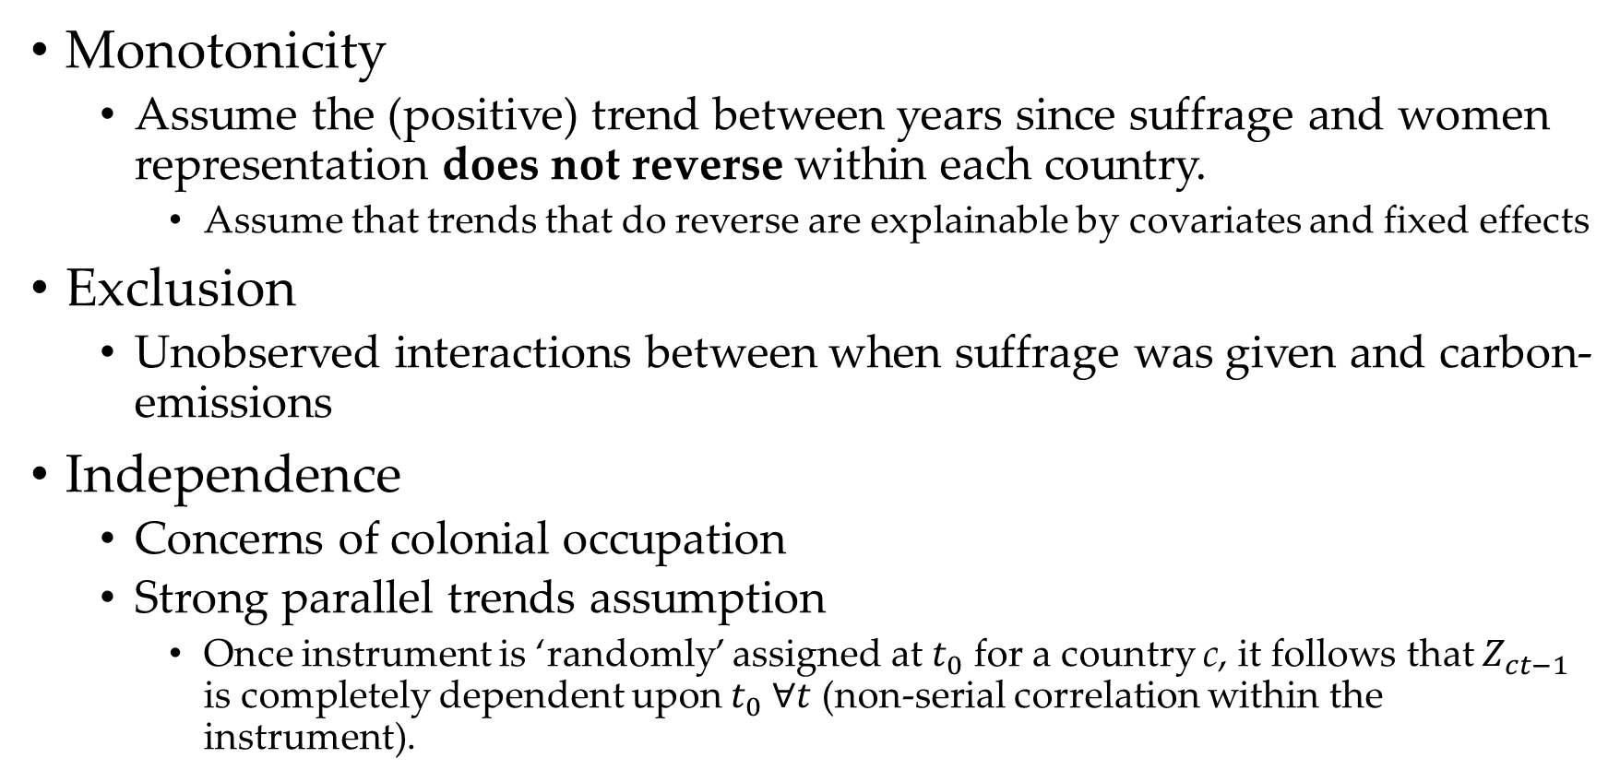
Assumptions for Identification - IV
Monotonicity
Assume the (positive) trend between years since suffrage and women representation does not reverse within each country.
Assume that trends that do reverse are explainable by covariates and fixed effects
Exclusion
Unobserved interactions between when suffrage was given and carbon-emissions
Independence
Concerns of colonial occupation
Strong parallel trends assumption
Once instrument is ‘randomly’ assigned at $t_{0}$ for a country c, it follows that $Z_{ct−1}$ is completely dependent upon $t_{0} ∀t$ (non-serial correlation within the instrument).

Slide 8
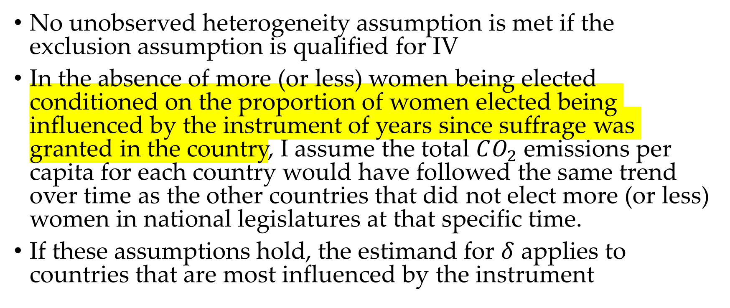
Assumptions for Identification - DiD
No unobserved heterogeneity assumption is met if the exclusion assumption is qualified for IV
In the absence of more (or less) women being elected conditioned on the proportion of women elected being influenced by the instrument of years since suffrage was granted in the country, I assume the total $CO_{2}$ emissions per capita for each country would have followed the same trend over time as the other countries that did not elect more (or less) women in national legislatures at that specific time.
If these assumptions hold, the estimand for $δ$ applies to countries that are most influenced by the instrument

Slide 9
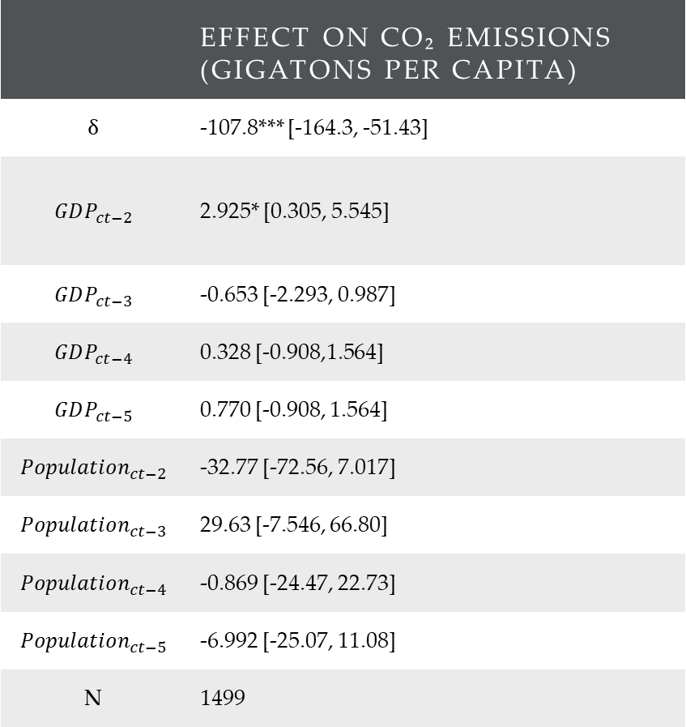
Regression Results
 | Effect on CO₂ Emissions (Gigatons per Capita)
$$δ$$ | -107.8*** [-164.3, -51.43]
$$GDP_{ct−2}$$ | 2.925* [0.305, 5.545]
$$GDP_{ct−3}$$ | -0.653 [-2.293, 0.987]
$$GDP_{ct−4}$$ | 0.328 [-0.908,1.564]
$$GDP_{ct−5}$$ | 0.770 [-0.908, 1.564]
$$Population_{ct−2}$$ | -32.77 [-72.56, 7.017]
$$Population_{ct−3}$$ | 29.63 [-7.546, 66.80]
$$Population_{ct−4}$$ | -0.869 [-24.47, 22.73]
$$Population_{ct−5}$$ | -6.992 [-25.07, 11.08]
N | 1499

Slide 10
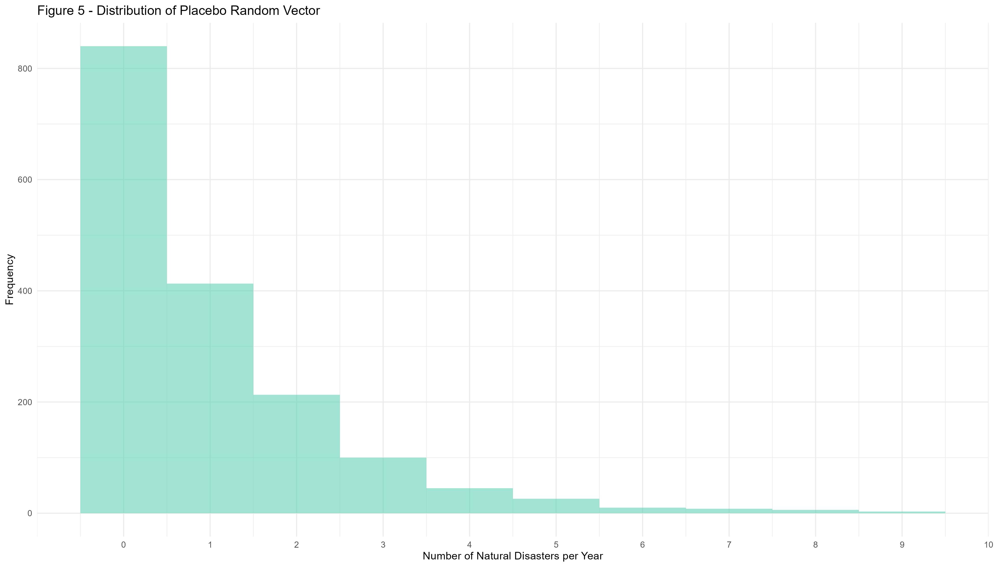

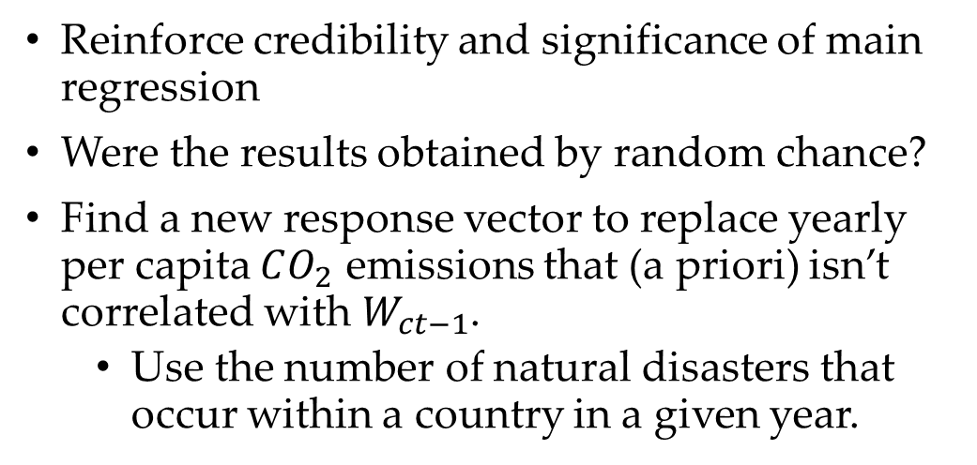
Placebo Regression
Reinforce credibility and significance of main regression
Were the results obtained by random chance?
Find a new response vector to replace yearly per capita $CO_{2}$ emissions that (a priori) isn’t correlated with $W_{ct−1}$.
Use the number of natural disasters that occur within a country in a given year.

Slide 11

Placebo Regression Results
 | Effect on CO₂ Emissions (Gigatons per Capita)
$$δ$$ | -2.824 [-8.282,2.634]
$$GDP_{ct−2}$$ | -0.205 [-0.520,0.109]
$$GDP_{ct−3}$$ | 0.314 [-0.176,0.804]
$$GDP_{ct−4}$$ | 0.328 [-0.908,1.564]
$$GDP_{ct−5}$$ | -0.280 [-0.576,0.0162]
$$Population_{ct−2}$$ | 0.856 [-3.615,5.327]
$$Population_{ct−3}$$ | -0.679 [-6.232,4.874]
$$Population_{ct−4}$$ | 1.689 [-2.111,5.488]
$$Population_{ct−5}$$ | -1.415 [-3.535,0.704]
N | 1499

Slide 12

Economic Implications & Conclusion
Support for causal thesis w/ limitations
Initial assumption that effective climate policy curbing economic activity may be incorrect
Establishes intertemporal link between women in legislature and carbon emissions
Future research to explore nuances and interactions between specific climate regulatory policies and women in government

